Slide 1
Social Media Key Performance Indicators (KPIs)

Slide 2
Social Media Metrics Classification
Engagement Metrics these metrics show how audiences are interacting with content.
Conversion Metrics these metrics demonstrate the effectiveness of your social engagement.
Consumer Metrics these metrics reflect how active customers think and feel about your brand.
Awareness Metrics these metrics show the current and potential audience.

Slide 3
1. Awareness Metrics

Slide 4
1.1. Brand Awareness
Brand Awareness is the attention your brand gets, across all social media, during a reporting period, or a specific span of time that yields statistically relevant data.
Attention can be expressed through a variety of social media metrics, including @mentions, shares, links, and impressions.
Reporting periods are also variable, usually lasting a week, a month, or a quarter.

Slide 5
1.1. Brand Awareness
How to track it:
STEP 1: Determine the attention metric(s) your organization wants tied to brand awareness. STEP 2: Determine the reporting period your organization wants tied to brand awareness. STEP 3: Be consistent. Consistency ensures that you’re benchmarking trends with accurate, dependable data.
Note: A brand monitoring tool (like Hootsuite) makes it easier to track every time someone mentions you on social media, with or without an @mention.

Slide 6
1.2. Audience Growth Rate
Audience Growth Rate measures the speed at which your brand’s following increases on social media. It’s how quickly you gain followers.
As access to the internet continues to increase around the world, brands’ social media followings will also increase. This can be called social media inflation, or the expectation of growth.

Slide 7
1.2. Audience Growth Rate
How to track it:
STEP 1: Measure your net new followers (on each platform) over a reporting period. STEP 2: Divide your net new followers by your total audience (on each platform) and multiply by 100 to get your audience growth rate percentage.
Note: You can track your competitors’ progress the same way.

Slide 8
1.3. Post Reach
Post Reach denotes how many people have seen a post since it went live.
This metric is easy to find and even easier to understand. Most importantly, it’s actionable, since it’s affected by the timing (i.e., when is your audience online?) and the content (i.e., what does your audience find valuable?) of your post.

Slide 9
1.3. Post Reach
How to track it:
STEP 1: Measure the reach of any given post. STEP 2: Divide the reach by your total number of followers and multiply by 100 to get your post reach percentage.
Note: On Facebook, the “When Your Fans Are Online” feature will tell you the optimal time to post. Use this data to increase your reach.

Slide 10
1.4. Potential Reach
Potential Reach measures the number of people who could, realistically, see a post during a reporting period.
In other words, if one of your followers shared your post with her network, approximately two to five percent of her followers would factor into the post’s potential reach.
Understanding this metric is important because, as a social marketer, you should always be working to expand your audience. Knowing your potential reach enables you to gauge your progress.

Slide 11
1.4. Potential Reach
How to track it:
STEP 1: Use a brand monitoring tool to track your total number of brand mentions. STEP 2: Record how many followers saw each mention (i.e., the audience of the account that mentioned you). STEP 3: Multiply those two numbers together to get your Theoretical Reach, or the absolute maximum number of people who could, in theory, see your brand mentions.
Note: Your potential reach is 2 to 5 percent of your theoretical reach.

Slide 12
1.5. Social Share of Voice (SSoV)
Social Share of Voice measures how many people are mentioning your brand on social media compared to your competitors.
Mentions can be either:
Direct (e.g., “@McDonald's”)
Indirect (e.g., “McDonald's”)
SSoV is, essentially, competitive analysis: how visible—and, therefore, relevant—is your brand in the market?

Slide 13
1.5. Social Share of Voice (SSoV)
How to track it:
STEP 1: Measure every mention your brand receives—direct and indirect—across your social networks. STEP 2: Measure your competitors’ mentions during the same reporting period. STEP 3: Add your mentions and those of your competitors to get the total industry mentions. STEP 4: Divide your brand mentions by the grand total and multiply by 100 to get your SSoV percentage.
Note: Using social media analytics tools will make this process easier.

Slide 14
2. Engagement metrics

Slide 15
2.1. Applause Rate
Applause Rate is the number of approval actions (e.g., likes, favorites) a post receives relative to your total number of followers.
When a follower likes or favorites one of your posts, she’s acknowledging that it’s valuable to her. Knowing what percentage of your audience finds value in the things you post can—and should—inform your content moving forward.

Slide 16
2.1. Applause Rate
How to track it:
STEP 1: Add up the total approval actions a post received over the course of a reporting period. STEP 2: Divide that number by your total followers and multiply by 100 to get your applause rate percentage.
Note: Use a social media impact tool to help track approval actions and simplify the process.

Slide 17
2.2. Average Engagement Rate
Average Engagement Rate is the number of engagement actions (e.g., likes, shares, comments) a post receives relative to your total number of followers.
It’s an important metric because higher engagement means your content is resonating with the audience. To prove that, track the engagement rate of every post. If you have a high engagement rate, the actual number of likes and shares and comments is irrelevant.

Slide 18
2.2. Average Engagement Rate
How to track it:
STEP 1: Add up a post’s total likes, comments, and shares. STEP 2: Divide by your total number of followers and multiply by 100 to get your average engagement rate percentage.
Note: The benchmark for this metric is different on every social media platform. Facebook and Twitter, for example, typically have lower engagement rates (e.g., 0.5 to one percent). Instagram, on the other hand, is known for its relatively high engagement rates (e.g., three to six percent).

Slide 19
2.3. Amplification Rate
Amplification Rate is the ratio of shares per post to the number of overall followers.
So It can be coined as the rate at which your followers take your content and share it through their networks.”
Basically, the higher your amplification rate, the more willing your followers are to associate themselves with your brand.

Slide 20
2.3. Amplification Rate
How to track it:
STEP 1: Add up the number of times a post was shared during a reporting period. STEP 2: Divide that number by your total number of followers and multiply by 100 to get your amplification rate percentage.

Slide 21
2.4. Virality Rate
Virality Rate is the number of people who shared your post relative to the number of views (i.e., impressions) it had during a reporting period.
Like the other metrics on this list, virality rate goes beneath the surface. It’s about more than just likes.
“A post that gets 17,000 likes may only get 0.1% virality,”, “while another post that receives 10,000 likes gets 9.97% virality—and that’s a far better post.”

Slide 22
2.4. Virality Rate
How to track it:
STEP 1: Measure a post’s impressions. STEP 2: Measure a post’s shares. STEP 3: Divide the number of shares by the number of impressions and multiply by 100 to get your virality rate percentage.

Slide 23
3. Conversion metrics

Slide 24
3.1. Conversion rate
Conversion Rate is the number of visitors who, after clicking on a link in your post, take action on a page (e.g., subscribe to your newsletter; download a gated content asset; register for a webinar).
A high conversion rate means your content is valuable and compelling to the target audience. From a social media standpoint, it’s a sign that your post was relevant to the offer. In other words, it kept its promise.

Slide 25
3.1. Conversion rate
How to track it:
STEP 1: Create a post with a call-to-action link. Use a URL shortener to make it trackable. STEP 2: Use the campaign reporting to track the total number of clicks and conversions generated by the post. STEP 3: Divide conversions by total clicks and multiply by 100 to get your conversion rate percentage.
Note: A post’s conversion rate can be high even if its traffic is low. The two metrics are mutually exclusive.

Slide 26
3.2. Click-Through Rate (CTR)
Click-Through Rate, or CTR, is how often people click on the call-to-action link in your post.
Not to be confused with other engagement actions (e.g., shares, likes, comments), your CTR is specifically tied to a link that brings the audience to additional content.
Tracking CTR, often and accurately, will give you invaluable insight into how compelling your offer is to the target audience.

Slide 27
3.2. Click-Through Rate (CTR)
How to track it:
STEP 1: Measure the total clicks on a post’s link. STEP 2: Measure the total impressions on that post. STEP 3: Divide the number of clicks by the number of impressions and multiply by 100 to get your CTR percentage.
Note: Don’t forget to measure clicks and impressions within the same reporting period.

Slide 28
3.3. Bounce Rate
Bounce Rate, is the percentage of page visitors who click on a link in your post, only to quickly leave the page they land on without taking an action.
Bounce rate lets you measure your social media traffic—and, in turn, ROI—against other sources of traffic (e.g., traffic from a Facebook post vs. traffic from an organic Google search).
If your social media bounce rate is lower than that of other sources, it’s proof that your social media campaigns are targeting the right audience—and, in turn, driving high-value traffic.

Slide 29
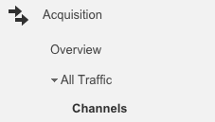
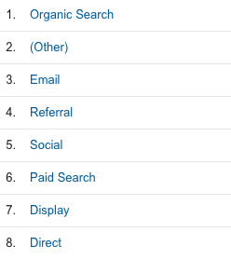
3.3. Bounce Rate
How to track it:
STEP 1: Set up Google Analytics. STEP 2: Open the “Acquisition” tab, and look under “All Traffic” for the “Channels” segment.
STEP 3: Click on the “Bounce Rate” button, which will rank all of the channels from lowest bounce rate to highest.
Note: Demonstrating the relative effectiveness of your social media efforts will go a long way in proving its value to the business.

Slide 30
3.4. Cost-Per-Click (CPC)
Cost-Per-Click, or CPC, is the amount you pay per individual click on your sponsored social media post.
Whether you choose to advertise on Facebook, Instagram, Twitter, or Linkedin, don’t focus on your total spend. Instead, look to your CPC. It’ll help you weigh if your investment in attention is efficient, or wasteful.

Slide 31
3.4. Cost-Per-Click (CPC)
How to track it:
STEP 1: Check your platform’s Ad Manager. STEP 2: Check it often.
Note: Never let your CPC campaigns go unattended for an extended period of time.

Slide 32
3.5. Cost Per Thousand Impressions (CPM)
Cost Per Thousands Impressions, or CPM, is the amount you pay every time a thousand people scroll past your sponsored social media post.
Unlike in a CPC campaign, a CPM post won’t necessarily drive action. It’ll only create impressions, views. Therefore, CPM is a faster and less expensive way to split test content.

Slide 33
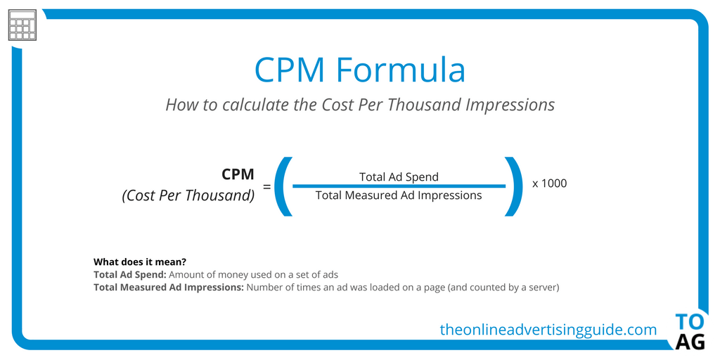
3.5. Cost Per Thousand Impressions (CPM)
How to track it:
STEP 1: Check your platform’s Ad Manager. STEP 2: Check it often.
Note: Never let your CPC campaigns go unattended for an extended period of time.

Slide 34
3.6. Social Media Conversion Rate
Social Media Conversion Rate is the total number of conversions that came from social media, expressed as a percentage.
Understanding this metric will give you clear insight into the effectiveness of each post in a campaign. In other words, it answers this question: how well does this offer resonate with our target audience?

Slide 35
3.6. Social Media Conversion Rate
How to track it:
STEP 1: Create a link in the post using a shortened URL that places a “cookie” on the user’s machine. STEP 2: Measure your total number of conversions. STEP 3: Divide the social media conversions by the total number of conversions and multiply by 100 to get your social media conversion rate percentage.

Slide 36
3.7. Conversation Rate
Conversation Rate is the ratio of comments per post to the number of overall followers you have.
It’s better than tracking comments without any context. After all, getting an average of 20 comments per post is a lot more impressive if you only have 200 followers.
Tracking your conversation rate will help you understand how much of your audience is compelled to add their voice to the content you post on social. Or in another words “Is what you are saying interesting enough to spark the most social of all things: a conversation?”

Slide 37
3.7. Conversation Rate
How to track it:
STEP 1: Use Hootsuite Analytics to pull the number of comments you received during a reporting period. STEP 2: Divide that number by your total number of followers and multiply by 100 to get you conversation rate percentage.

Slide 38
4. Customer metrics

Slide 39
4.1. Customer Testimonials
Customer Testimonials are any customer review, assessment, comment, endorsement, or interview relating to a brand.
Ultimately, great testimonials are the product of customer delight. If your brand makes people happy, they’ll be more likely to share their good experience with others.
The benefits are clear: a consistent stream of sincere testimonials on social media will garner trust and credibility while boosting your brand’s presence.

Slide 40
4.1. Customer Testimonials
Ways to get customer testimonials:
Ask your best customers to leave a review. Never offer to compensate them for their effort, of course, as that would undermine your credibility.
Run a social media campaign that encourages people to create written, video, or online testimonials about your product, service, or mission.
Link to your Google My Business review form to make leaving testimonials a simple, seamless process for your brand evangelists.

Slide 41
4.2. Customer Satisfaction (CSat) Score
Customer Satisfaction, or CSAT, is a metric that measures how happy people are with your product or service.
Usually, the CSAT score is the product of one, straightforward question: How would you describe your overall satisfaction with this product?
Customers are then asked to rate their satisfaction on a linear scale, either numerically (e.g., one to 10) or sentimentally (e.g., Poor; Fair; Good; Great; Excellent).
CSAT is a common way to understand how customers feel about your brand, mainly because it’s clear, concise, and easy to administer, especially on social media.

Slide 42
4.2. Customer Satisfaction (CSat) Score
How to track it:
STEP 1: Create a CSAT survey on social media. STEP 2: Add up the sum of all the scores. STEP 3: Divide the sum by the number of respondents and multiply by 10 to get your CSAT score.

Slide 43
4.3. Net Promoter Score (NPS)
Net Promoter Score, or NPS, is a metric that measures customer loyalty.
Unlike CSAT, NPS is good at predicting future customer engagement because it is the product of one—and only one—specifically phrased question: How likely is it that you would recommend our [company/product/service] to a friend?
Customers are then asked to answer on a scale of zero to 10. Based on their response, each customer is grouped into one of three categories:
Detractors: 0 – 6 score range
Passives: 7 – 8 score range
Promoters: 9 – 10 score range
NPS is unique in that it measures customer satisfaction as well as future sales, which has made it a valuable metric for organizations of all sizes.

Slide 44
4.3. Net Promoter Score (NPS)
How to track it:
STEP 1: Create a NPS survey on social media. STEP 2: Subtract the number of promoters from the number of detractors. STEP 3: Divide that number by the total number of respondents and multiply by 100 to get your NPS.

